Slide 1
Improved Source of Drinking Water
IBM VIRTUAL INTERNSHIP USING IBM CLOUD
Presented By:
Sri Sai Satya Manideep Gannavaram KL University CSE

Slide 2
OUTLINE
Problem Statement
Proposed System/Solution
System Development Approach
Algorithm & Deployment
Result (Output Image)
Conclusion
Future Scope
References

Slide 3
Problem Statement
Many parts of India still face problems in getting safe and reliable drinking water. Even though there are government programs and global goals like the Sustainable Development Goals (SDGs), big differences remain between states and between rural and urban areas. In some regions, most people have access to clean water, while in others the situation is much worse. This project uses data from the 78th Round of the Multiple Indicator Survey (MIS) to study how much of the population has access to improved drinking water. It also looks at related points like the use of clean cooking fuel and migration, to understand where the gaps are and what changes are needed.

Slide 4
Proposed solution
Data Collection:
I uploaded the MIS 78th Round dataset on drinking water access into IBM Watson Studio using IBM Cloud Lite.
Data Preparation:
Using Data Refinery, I cleaned the data by fixing column types and removing empty values.
Key fields like State, Rural/Urban, and % of Access were prepared for analysis.
Data Analysis & Visualization:
I created bar, pie, and 3D charts using Watson Studio’s tools to show water access by state and compare rural vs urban areas.
Project Output:
All the visuals and results were saved in the IBM Cloud project and used for my internship PPT

Slide 5
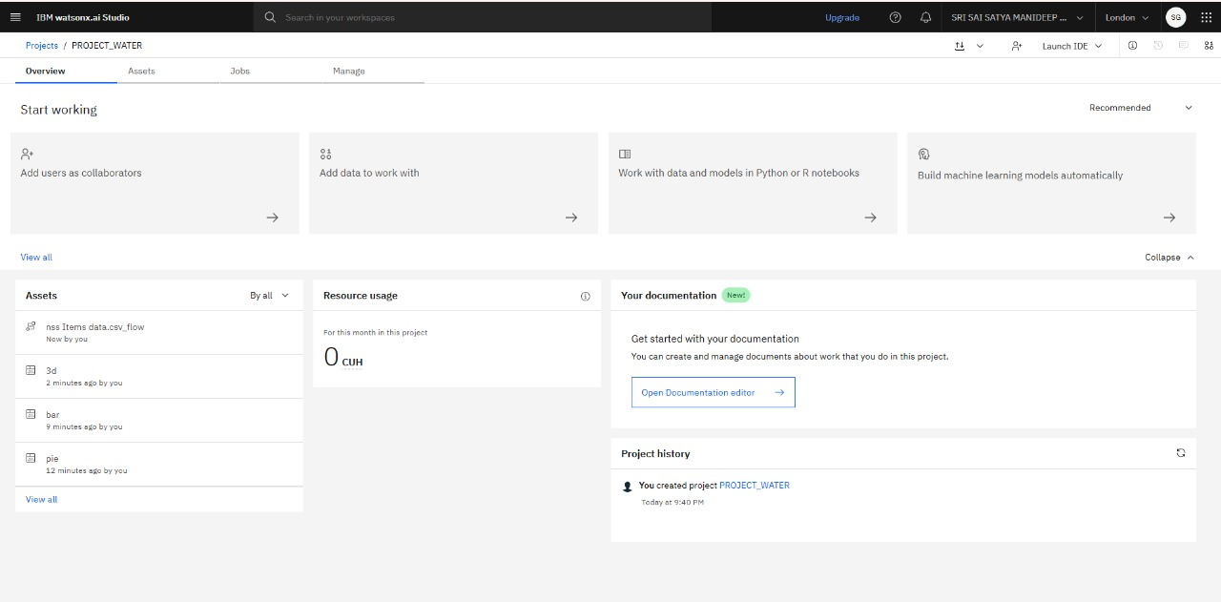
PROPOSED SOLUTION SCREENSHOT
“Project set up in IBM Cloud using Watson Studio and Cloud Object Storage for data analysis.”

Slide 6
System Approach
System Requirements:
I created an IBM Cloud Lite account and set up a project.
I used Watson Studio for all the data work and Cloud Object Storage to keep the dataset safe.
Everything was done on my laptop using only cloud tools (no extra software needed).
Libraries & Tools I Used:
IBM Watson Studio Data Refinery – for cleaning and preparing the dataset.
Pandas, Matplotlib, and Seaborn – used inside Watson Studio for extra checks and visualizations.
Built‑in IBM visualization tools – to make the bar chart, pie chart, and 3D chart quickly.
What I Did:
I uploaded the MIS 78th Round dataset into Assets in Watson Studio.
I cleaned the data (fixed columns, removed blanks) in Data Refinery.
I used the visualization features to create charts that show water access patterns.
All outputs were saved and used directly in my PPT.

Slide 7
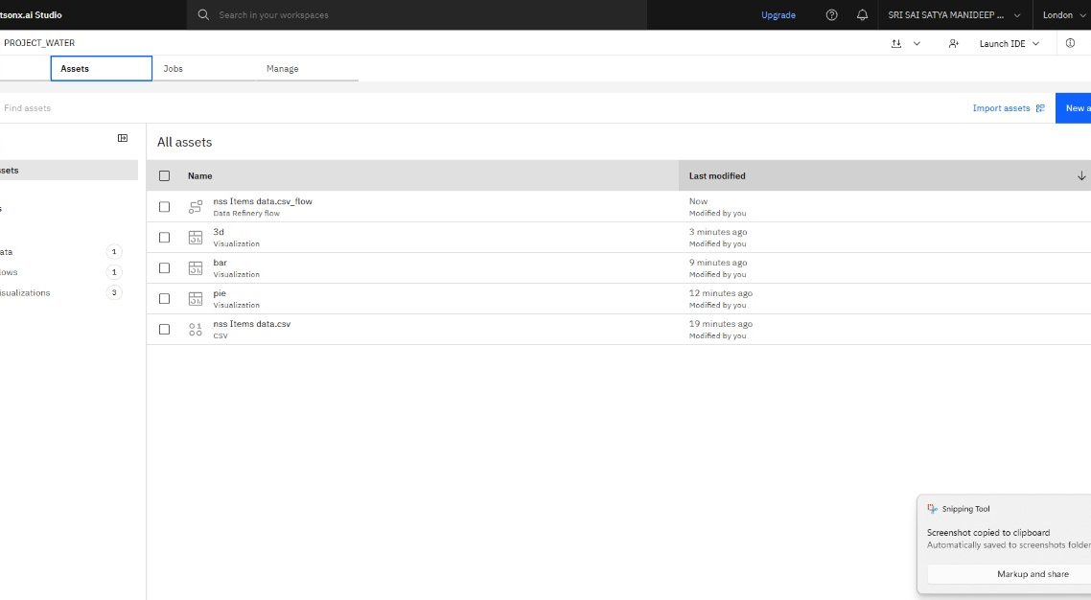
SYSTEM APPROACH SCREENSHOT
“MIS 78th Round dataset uploaded and stored in IBM Watson Studio Assets for analysis.”

Slide 8
Algorithm & Deployment
Data Input:
I used the MIS 78th Round dataset on Improved Drinking Water from AI Kosh.
Important fields like State, Rural/Urban, and % of Water Access were selected for analysis.
Processing Steps:
In IBM Watson Studio Data Refinery, I cleaned the dataset by fixing column types and removing empty values.
I organized the data so it could be easily compared across states and sectors.
Visualization & Analysis:
I used IBM Watson Studio’s visualization tools to create bar, pie, and 3D charts.
These charts highlighted state‑wise differences and rural vs urban patterns.
Deployment:
All work was kept in IBM Cloud, so the dataset, cleaned data, and charts stayed linked to the project.
Screenshots of the visuals and process were taken and added into the PPT for final reporting.

Slide 9
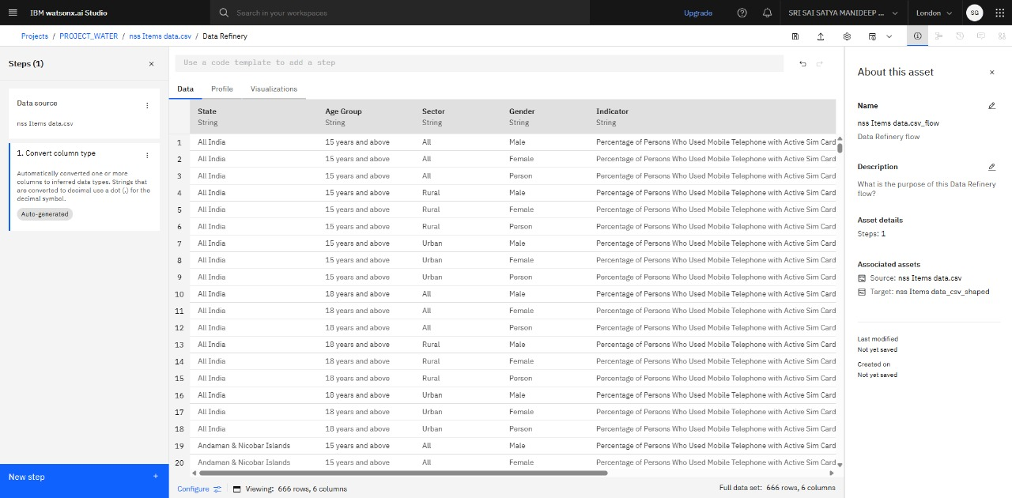
ALGORITHM & DEPLOYMENT SCREENSHOT
“Data Refinery used in IBM Watson Studio to prepare and structure the dataset for analysis.”

Slide 10
Result
A Bar Chart was made to compare state‑wise access to improved drinking water.
A Pie Chart showed how the data is distributed across states and gave a clear view of the proportions.
A 3D Chart was built to highlight Rural vs Urban vs All access levels for each state.
These visuals clearly showed which states have high access, which states lag behind, and how rural and urban areas differ.
I created different charts using IBM Watson Studio to show the findings from the MIS 78th Round dataset.

Slide 11
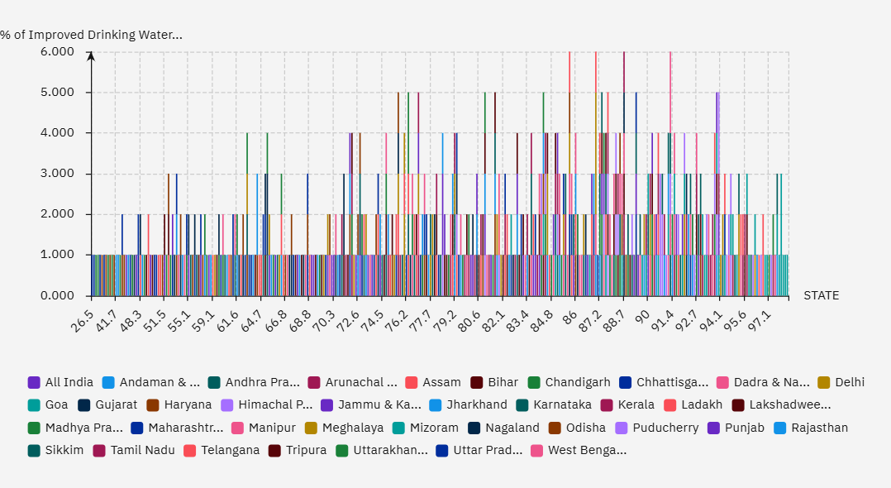
Bar chart screenshot
“Bar Chart – State-wise access to improved drinking water”

Slide 12
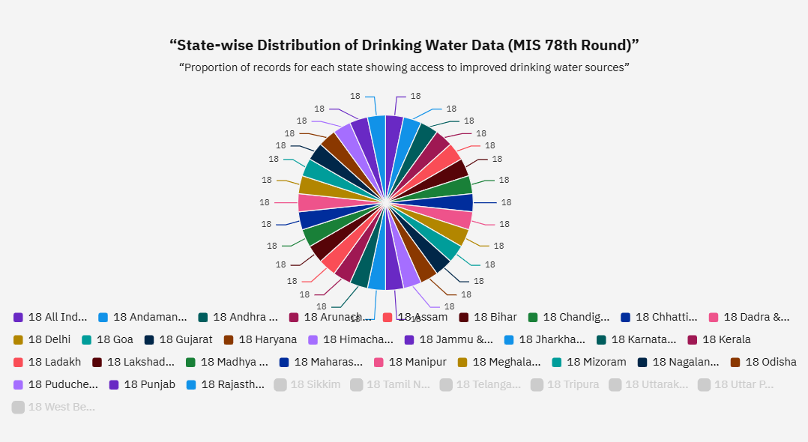
Pie chart screenshot
“Pie Chart – Distribution of water access across states”

Slide 13
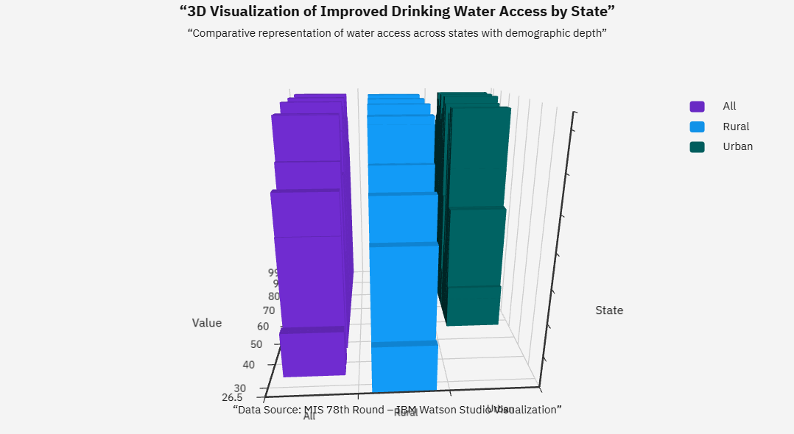
3D chart screenshot
“3D Chart – Rural vs Urban vs All comparison”

Slide 14
Conclusion
The MIS 78th Round data showed that access to improved drinking water is uneven across India.
Some states like Kerala, Goa, and Punjab have very high access levels, while others like Bihar and Jharkhand are still behind.
Rural areas generally have slightly lower access compared to urban areas, which shows the need for more focus on villages.
Using IBM Cloud and Watson Studio made it easy to clean the data, create visuals, and understand the patterns clearly.
The findings can help policy makers and organizations see where more work is needed to improve drinking water access.

Slide 15
Future scope
The same method can be used on larger or newer surveys to track changes in water access over time.
AI models can be added later to predict which areas might face water shortages in the future.
Linking with IoT devices or sensors can help monitor water quality in real time.
The visuals can be expanded into a dashboard for government and public use.

Slide 16
References
AI Kosh Dataset – Improved Source of Drinking Water, MIS 78th Round
IBM Cloud Documentation – https://cloud.ibm.com/docs
IBM Watson Studio User Guide – https://dataplatform.cloud.ibm.com
Sustainable Development Goals (SDG 6 – Clean Water and Sanitation) – https://sdgs.un.org/goals

Slide 17
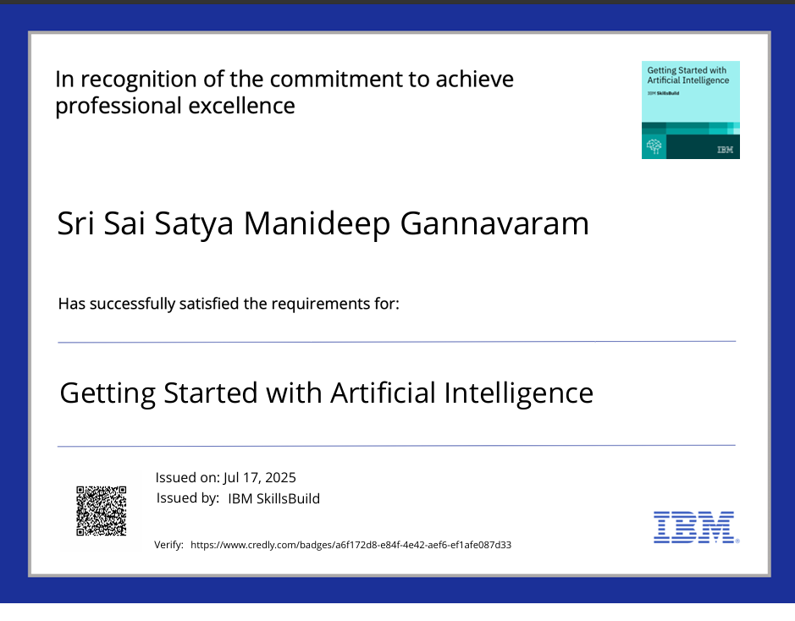
IBM Certificate-1 (getting started with AI)

Slide 18
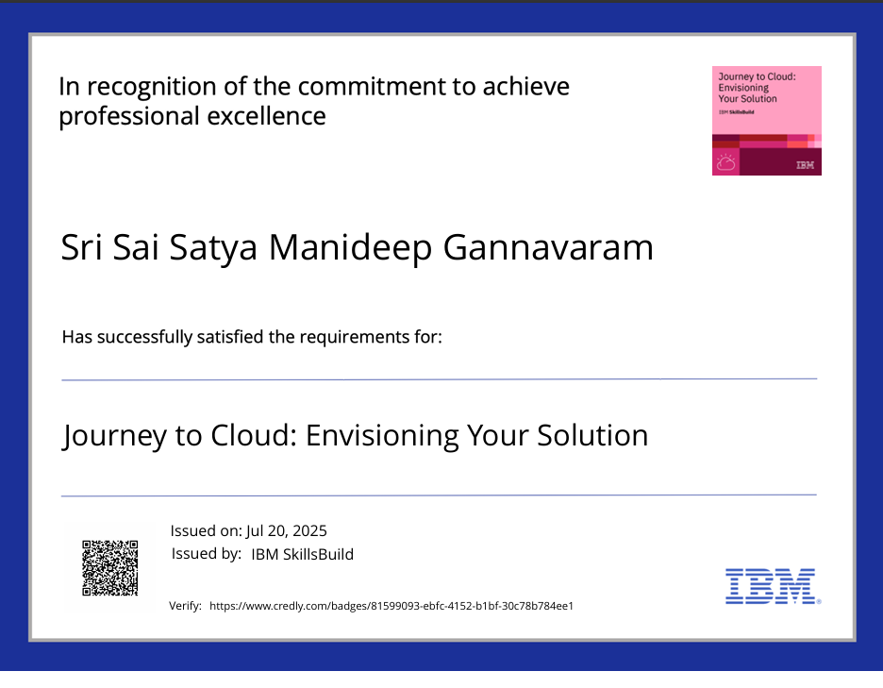
IBM Certificate-2 (Journey to Cloud)

Slide 19
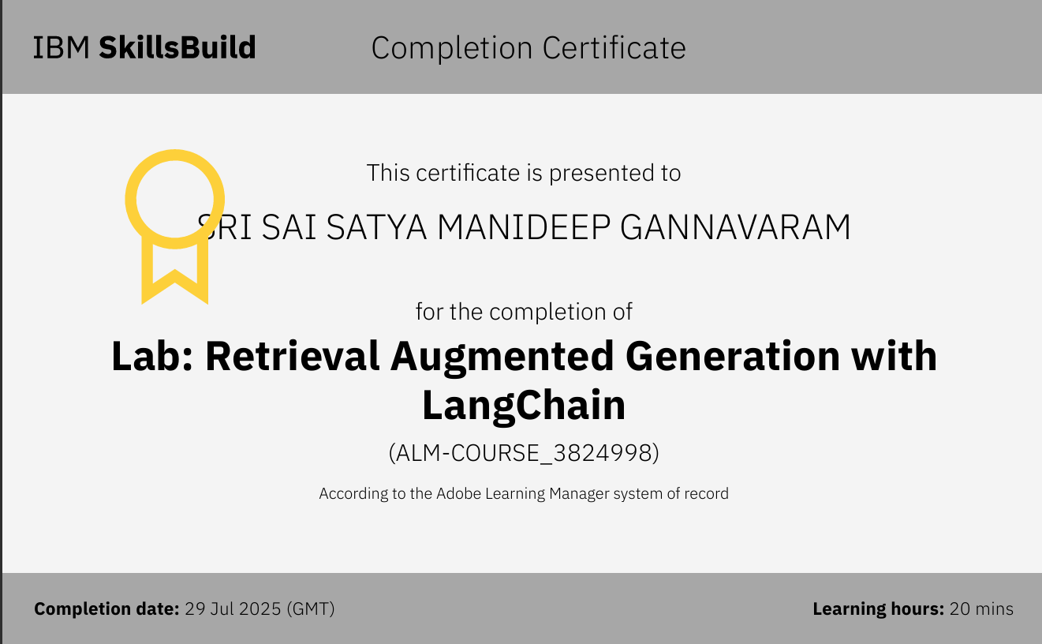
IBM Certificate-3 (RAG Lab)

Slide 20
THANK YOU

